Slide 1

Nurse Dataset: Higher Systolic Blood Pressure ?
Group C Member
Betty
Deen
Steven
Jaffa

Slide 2
Introduction- Background
Systolic blood pressure quantifies the pressure exerted by your blood against your artery walls when your heart beats
Nurse Blood Pressure Study collected data from 203 nurses aged 24-50 working in Los Angeles
Systolic and diastolic blood pressure collected for each subject throughout the day
Also documented age,family history of hypertension, menstrual phase, day, and self-reported mood scores

Slide 3

Research question
What factors are associated with higher systolic blood pressure?

Slide 4
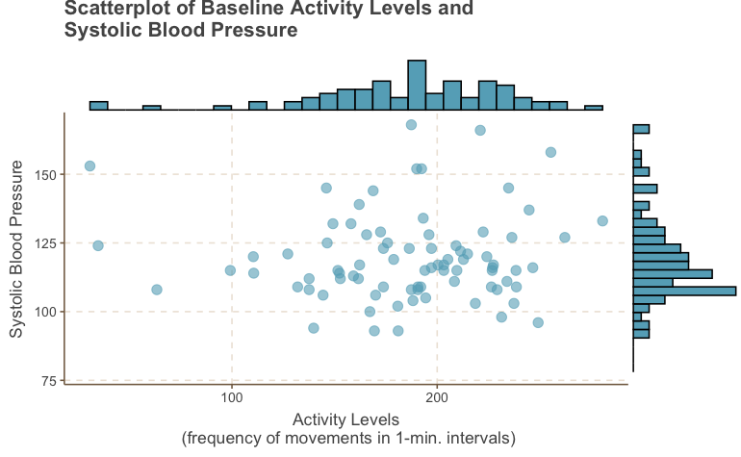

Slide 5
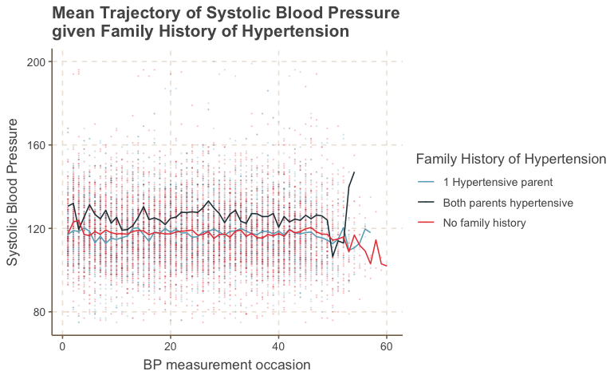

Slide 6
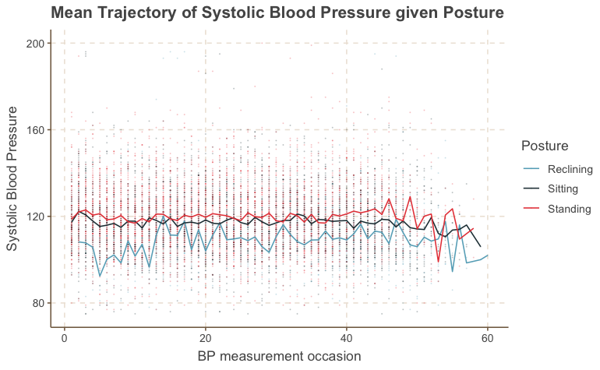

Slide 7
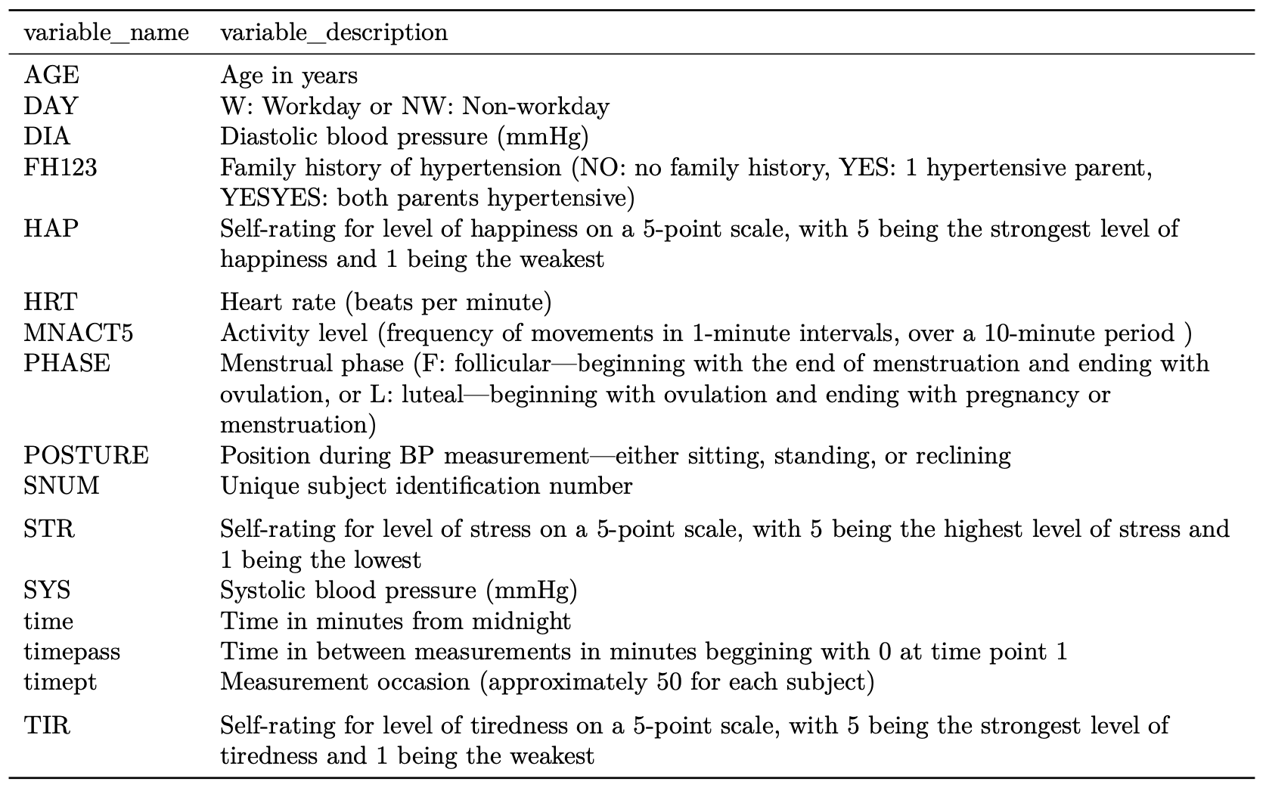
Method - Variable Selection

Slide 8
Method - Model
Linear Mixed Effect Model
Analyzing longitudinal and clustered data
The outcome variable is a continuous variable
Generalized Estimating Equations
Focused on estimating population-averaged effects
Since there are 45 to 50 observations per individual on average, the covariance between observations will be extremely small

Slide 9
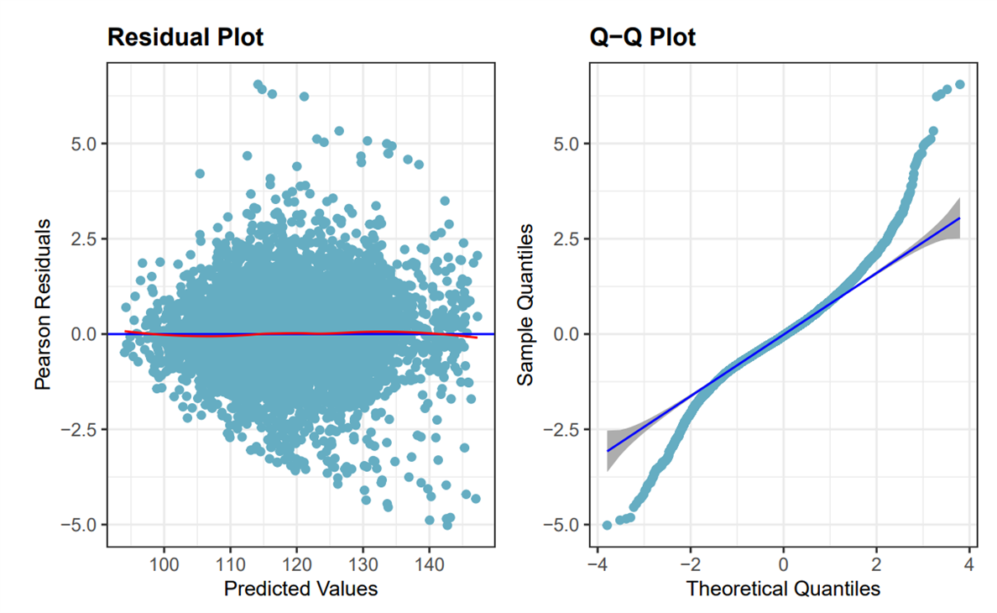
Model Assumption Check

Slide 10
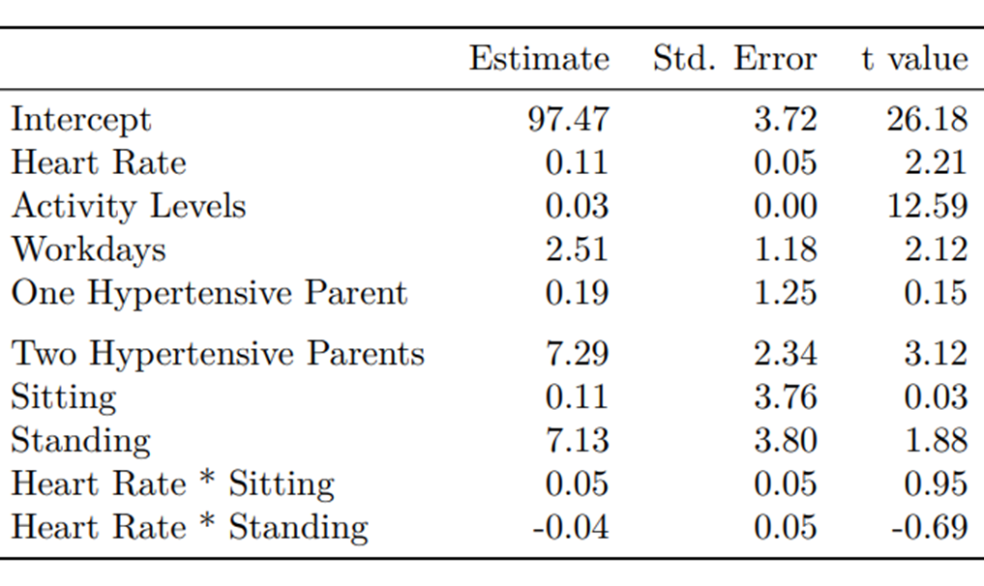
Results: Main effect
Model Equation:
Blood Pressure ~ Heart Rate + Activity Level + Day + Family History + Posture + Heart Rate×Posture
• On average, compared to a nurse with no family history of hypertension, a nurse with both parents hypertensive will result in 7.29 units (in mmHg) higher in systolic blood pressure.
• On average, if keeping heart rate constant, comparing standing to reclining while taking the blood pressure measurement, systolic blood pressure will increase by 7.09 units (in mmHg).

Slide 11
Discussion - Limitation
Missing data limitation (delete the column that contains factors that are self-rated): use other imputation method such as last value carry forwards to deal with this missing mechanism
Assumptions may not be valid (normality assumption for our final model does not hold) : Model assume linearity, Normality, Homoscedasticity and Independence Further investigation on residual independence and linearity between the response variable and predictors

Slide 12
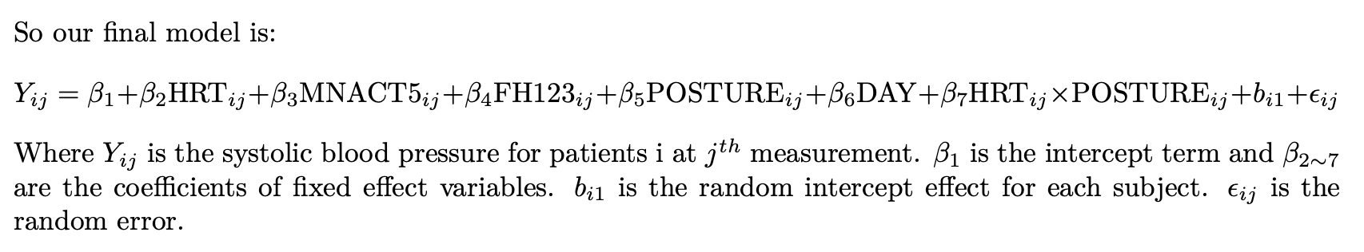
Conclusion

Slide 13


Slide 14


